Slide 1

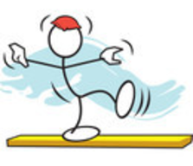

Transitions between therapy and community exercise:
Falls prevention cross sector working
Not all strength and balance programmes reduce falls
Dose, strength progression and balance challenge matter
Recommendation/referral makes a difference to uptake and adherence

Slide 2

Introductions
Dawn Skelton, Director LLT, Professor of Ageing & Health, Glasgow Caledonian University, Chair: British Geriatrics Society Rehabilitation Group, Member National Falls Prevention Coordination Group
Bex Townley, Director LLT, Senior Activity and Health Practitioner, FCIMSPA
Hannah Barbour, AGILE Falls & Bone Health Officer
Steffi Bailey, AGILE Falls & Bone Health Officer
Sarah De Biase, AGILE Falls & Bone Health Officer
Supporting:
  Sarah Lambert, AGILE Education Officer
  Susanne Arnold, AGILE Chair

Slide 3
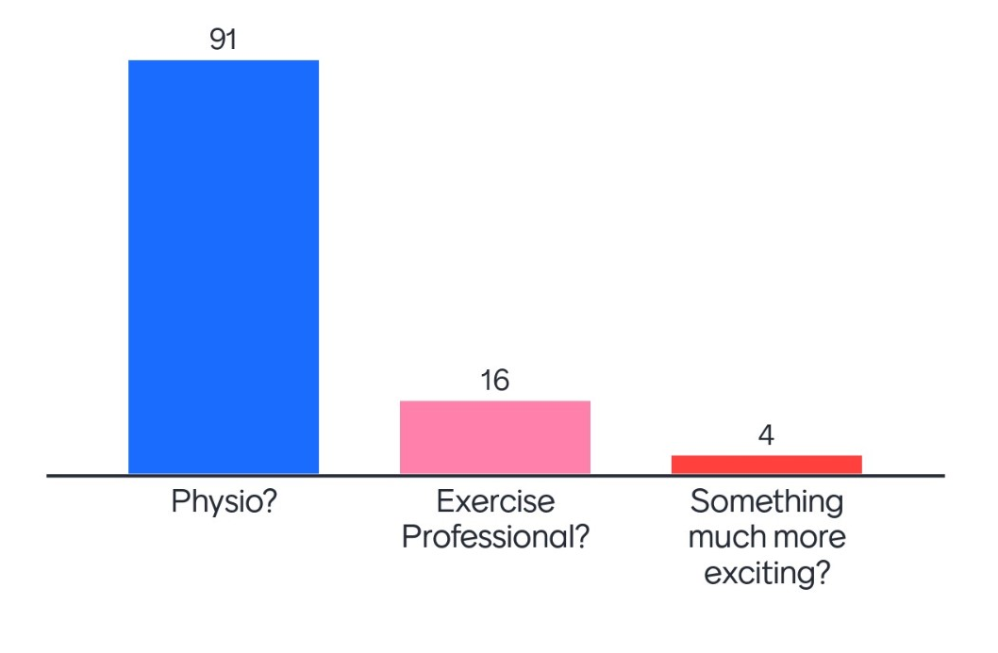
Share your profession with us…
Log on to: www.menti.com
Use code: 5802 3759

Slide 4
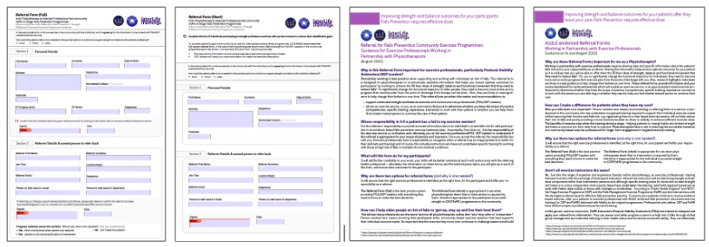

Referral Forms
https://agile.csp.org.uk/content/referrals

Slide 5






Housekeeping
Please keep your microphone on mute during the session unless you are speaking.
This session is being recorded.
Please use the chat box to raise any questions
Please keep your phones/devices on silent during the session
Grab yourself a drink before we start.
If you need any help with Zoom functionality during the session, please contact: agile.educationofficer@gmail.com
Notes:
No formal break – take refreshment breaks as & when
Slides will be shared after the event

Slide 6
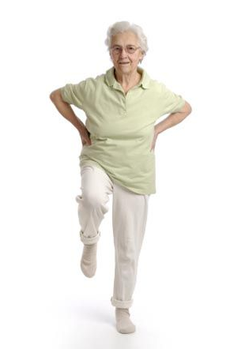
Aims
Update on falls prevention exercise evidence base
Indications for different evidence-based falls or generic strength and balance training programmes
Describe differences between Otago and FaME (OEP Leaders and Postural Stability Instructors)
Rationale for high quality information sharing which follows the individual throughout their falls exercise pathway
Overcoming barriers to optimising outcomes for those who have fallen/are at risk of falling
Resources to support achieving dose and seamless falls prevention exercise care pathways
Call to Action
Q&A

Slide 7

Continued Collaboration
Shared purpose
Optimise partnership working between physios & exercise professionals across exercise pathways
And shining a light on falls prevention: achieving sufficiently dosed exercise for falls prevention
Notes:
Sarah…

Slide 8


Later Life Training, BASES & AGILE Collaboration Guidance
What we promised back in 2019…
Partnership working to:
Ensure clearer understanding the training of exercise professionals
Define scope of practice & responsibilities of exercise professionals
Show what evidence-based programmes should look like (face to face/virtual/blended)
Give clarity about who goes where and when
Differentiate btw formal referrals vs recommendations
Support on-going service improvement
@AGILECSP @LaterLifeTrain @bases_sig
Notes:
BASES, LLT and AGILE Collaboration Guidance:
Sets out to:
Give a clearer understanding the training of exercise professionals
Define the scope of practice and responsibilities of both professional groups
Articulate clearly what evidence-based falls prevention programmes should look like across the continuum (face to face/virtual/blended)
Give clear direction about who goes where and when
Provide greater understanding of the need for formal referrals vs recommendations/signposting, and the process and records to support these access routes
Support on-going service improvement – reviewing processes and quality assurance
Next steps will include consultation with AGILE physiotherapist around the guidance/fit for purpose – so we can move forward with scalability of agreed referral pathways

Slide 9
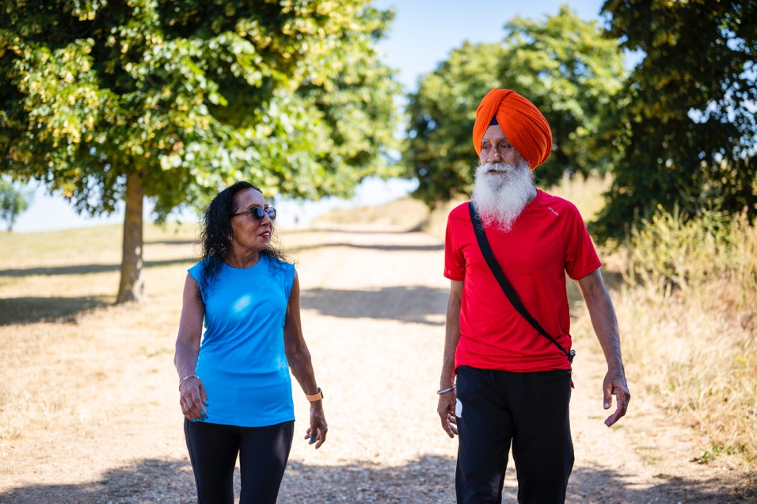
What words come to mind after reviewing the LLT/AGILE referral forms?
Log on to: www.menti.com
Use code: 2290 5717
Give us up to 3 words

Slide 10
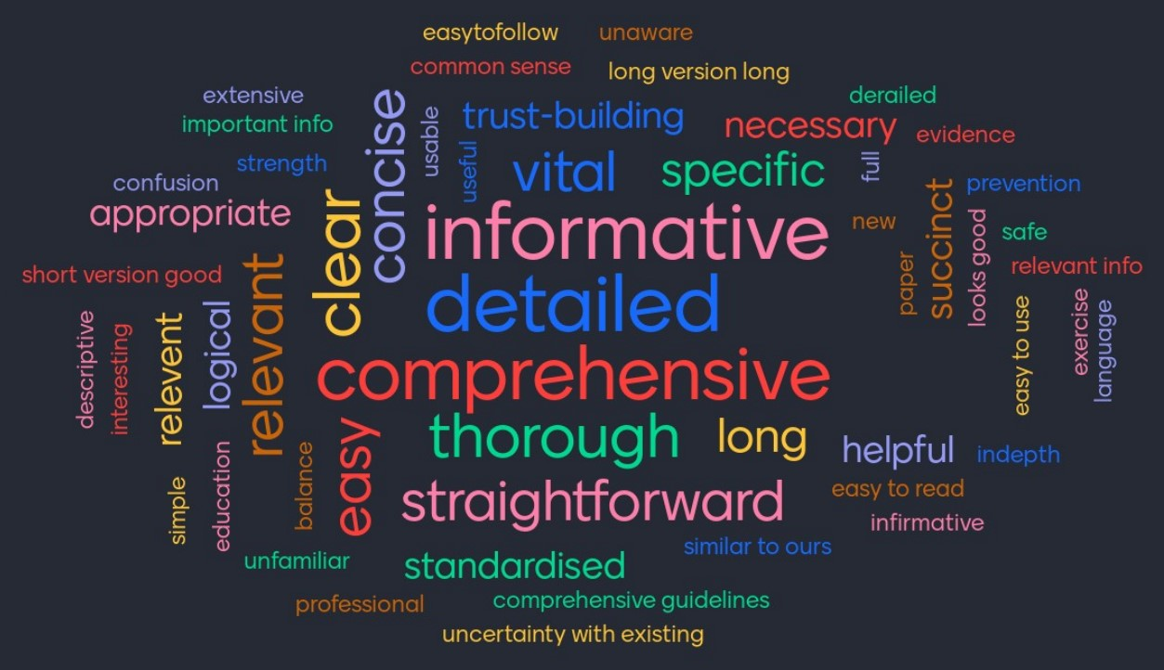

Slide 11
Update on Falls Prevention Evidence and Policy

Slide 12
The NFPCG and Falls and Fractures Prevention in the NHS Long term Plan
Section 1.17, P.17 'Extending independence as we age requires a targeted and personalised approach'…'Falls prevention schemes, including exercise classes and strength and balance training, can significantly reduce the likelihood of falls and are cost effective in reducing admissions to hospital';
Section 6.17 ix, P.108. 'We will work on falls and fracture prevention, where we know that a 50% improvement in the delivery of evidence-based care could deliver £100 million in savings.'

Slide 13
Cost effectiveness
Return on Investment
Exercise programmes (50 hrs+ > 6 mths, 3 x p/w)
  Falls Management Exercise (FaME/Postural Stability Instructor PSI Led)
  Otago Exercise Programme (OEP)
  Tai Chi
  Fidelity to original effective components (dose, frequency, intensity, challenge, resistance, right population)
https://www.gov.uk/government/publications/falls-prevention-cost-effective-commissioning

Slide 14
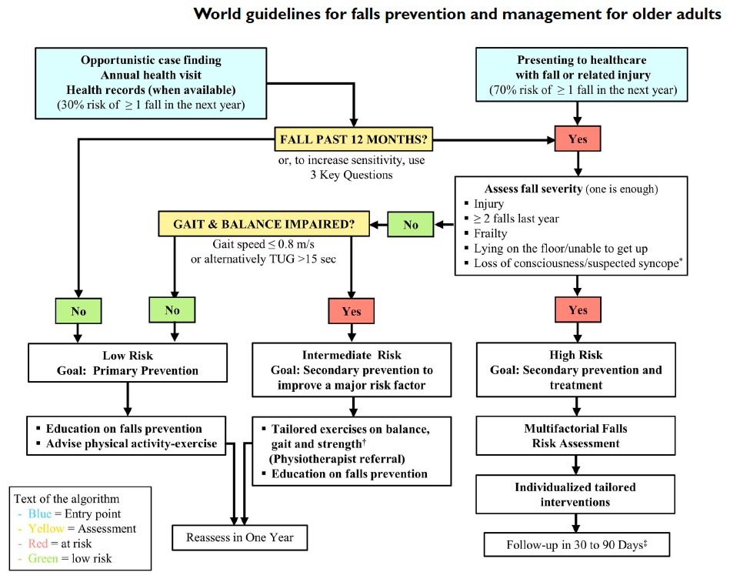
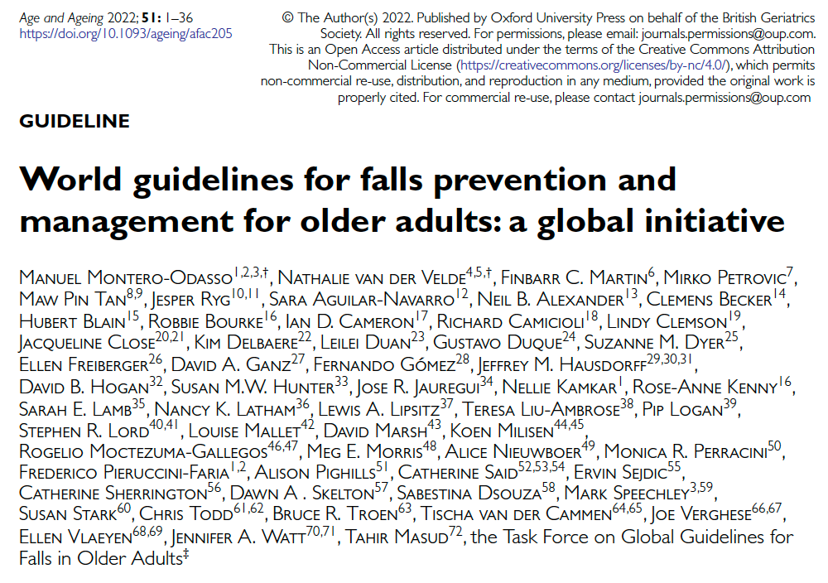
Fall in past 12 months?
Fall severity?
Gait/balance impaired?
Montero-Odasso et al. Age Ageing 2022
Notes:
DS – I won’t spend much time at all on these, more just raising awareness they exist. This slide I will just say the algorithm includes referral to falls prevention exercise if gait speed lower than 0.8m/s and /ot TUG >15 secs IRRESPECTIVE OF WHETHER THEY ARE FALLERS/FEARFUL etc!! So exercise referral should be the cornerstone of MDT Treatment

Slide 15
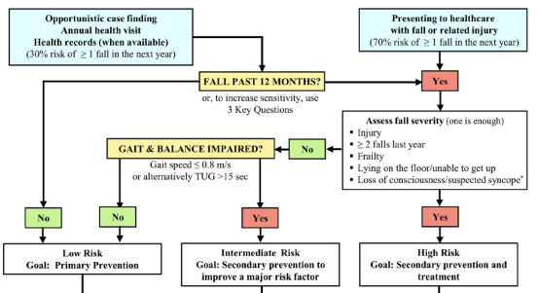
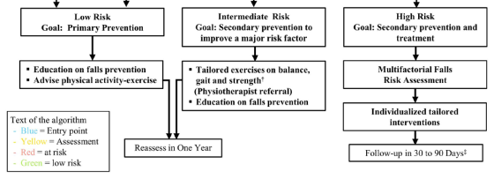
Montero-Odasso et al. Age Ageing 2022
Notes:
DS – I won’t spend much time at all on these, more just raising awareness they exist. This slide I will just say the algorithm includes referral to falls prevention exercise if gait speed lower than 0.8m/s and /ot TUG >15 secs IRRESPECTIVE OF WHETHER THEY ARE FALLERS/FEARFUL etc!! So exercise referral should be the cornerstone of MDT Treatment

Slide 16
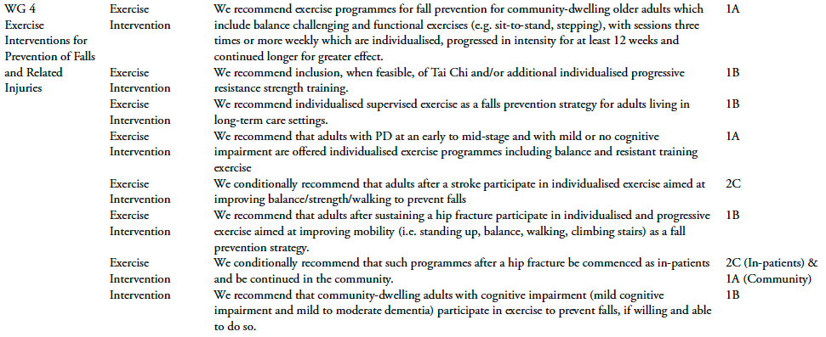

Guidelines for exercise for those at risk of falls
Montero-Odasso et al. Age Ageing 2022
Notes:
Here I will read the first and second recommendation – then just point out that the same exercise is recommended for PD, Stroke, post hip fracture and those with cognitive impairment and that ANYONE at high risk of falls should be offered an exercise intervention

Slide 17

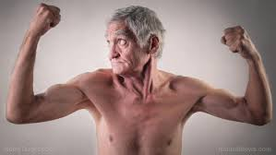

The evidence…..
Exercise for preventing falls in older people living in the community
reduces rate of falls by 23% (RaR 0.77)
reduces the number of people experiencing one or more falls by 15% (RR 0.85)
  (both falls outcomes irrespective of high or lower risk of falls at baseline)
may reduce fall related fractures (RR 0.73)
may reduce falls requiring medical attention (RR 0.61)
Is the most effective single intervention in MFT programmes
108 RCTs with 23,407 participants in 25 countries
Sherrington et al. Cochrane Review 2019; Hopewell et al. Cochrane Review 2018

Slide 18
Exercise for preventing falls in older people living in the community
Sub group analysis:
Balance & Functional Exercises
  reduces rate of falls by 24%
  reduces number of people experiencing falls by 13%
Multiple types of exercise (Balance, Functional & resistance exercise)
  reduces rate of falls by 35%
  reduces number of people experiencing falls by 22%
Tai Chi
  may reduce rate of falls by 19%
  may reduce number of people experiencing falls by 20%
Programmes that are primarily based on resistance exercise, dance or walking have uncertain effects.
108 RCTs with 23,407 participants in 25 countries
9 cluster RCTs
Average age 76 and 77% women
First Cochrane Review on Falls Interventions was published in 2008, updated 2009. In 2012 split into 2 reviews (MF, Exercise)
Sherrington C et al. Cochrane Database of Systematic Reviews 2019.

Slide 19


The devil is in the detail
Not all falls prevention exercise programmes work
Sherrington et al. Cochrane Review 2019

Slide 20
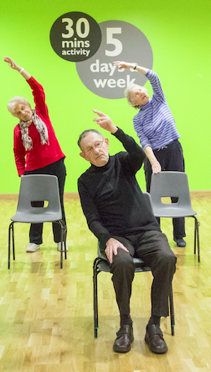
Programme Fidelity Matters
Effective:
  Types of exercise
  Components of fitness
  Dose
    Frequency / time / duration
  Behaviour change support
  Physical literacy
If you have programmes that work, replicate them with fidelity!

Slide 21
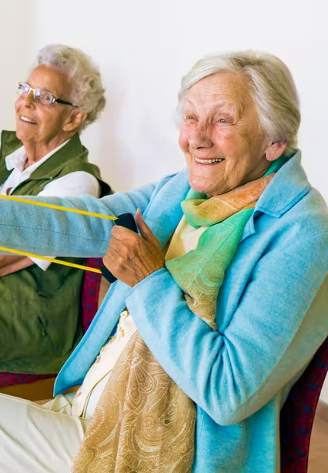
Fundamental Principles
Fundamental to ensure the provision of a SAFE, INDIVIDUALISED and EFFECTIVE training dose to patients
SPECIFICITY: responses to exercise training are specific to the stimulus induced by the exercise task
OVERLOAD: A greater than habitual stress or load on the body is needed to induce adaptation
PROGRESSION: A gradual and systematic increase in stress placed on the body is necessary to induce continual training adaptation over a period of time
EFFECTS STOP WHEN DISCONTINUE
Notes:
These are FUNDAMENTAL considerations for effective exercise prescription.
Might be worth turning Specificity, Overload and progression into a table just to make it visually different.

Slide 22
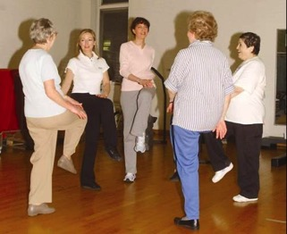
The evidence….. What works best?
Functional balance and strength
  Highly challenging + progressive
Frequency 3 x per week (for ≥ 2 hours total)
Duration ≥ 6 months
AT LEAST 12 WEEKS (Dose ≥ 50 hours)
These types of exercise also reduce fear of falling
No evidence to support physical activity (eg. walking, dance) or resistance training alone
Sherrington et al., JAGS 2008, NSWPHB 2011, BJSM 2016;
Cochrane Review 2019; Kendrick Cochrane Review FoF 2014
EFFECTS STOP WHEN DISCONTINUE

Slide 23
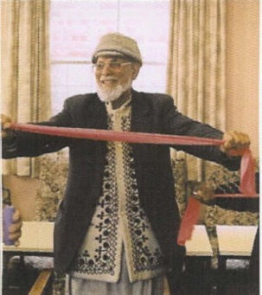
Exercise for frailty and sarcopenia outcomes?
Exercise interventions appear to be effective in managing the various components of frailty and preventing/delaying the onset of frailty
What works:
  duration ≥6 months
  sessions lasting 45-60 minutes
  ≥ 3 per week
  multicomponent exercise
Shorter programmes did not improve outcomes
Walston et al. Clin Geriatr Med 2018; Silva et al. J Frailty Aging 2017; Lee et al. J Clin Geront Geriatr 2012; Beaudart et al. Osteoporosis Int 2018
@GCUReach #EUGMS22

Slide 24

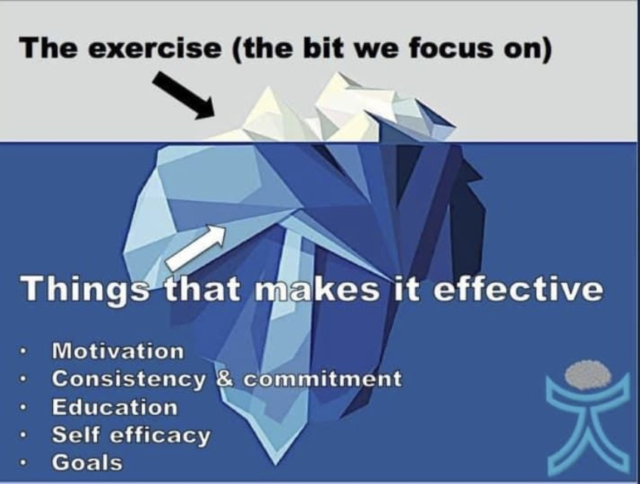
An effective exercise programme is not just a ‘set’ of exercises
Examples from successful falls and exercise programmes
A range of strategies that support participants eg.
  Goal setting and self monitoring
  Overcoming obstacles and difficulties
  Educating the participant
  Highlighting successes
  Providing individual and group support
  Social connectedness
These can best be supported over time by trained specialist instructors to ensure effective dose
Adapted from Ben Cormack

Slide 25

Pragmatic delivery
Otago – PREFIT study
  At 4-8 months there was a small decrease in falls rate (21%) not sustained at 12 months
  6 mth intervention (rather than 12)
  Sub-optimal progression or prescription of ankle weights
    Only 42% had an increase in ankle weights (only 17% had two or more increases)
  Little focus on walking programme
  Average 5 contacts for motivation/progression
  Only 40% of MF group offered exercise? Uptake poor
Giving someone a home exercise booklet does not mean they will do it!
Bruce (2021) Health Tech Assess; Lamb (2021) NEJM; Iliffe et al. (2014) Health Tech Assess

Slide 26
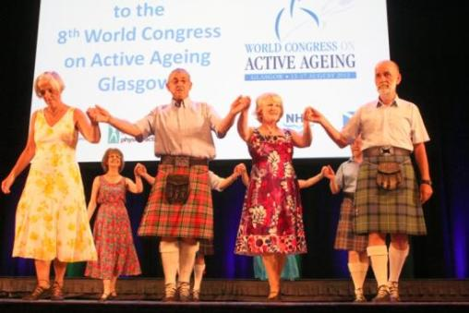
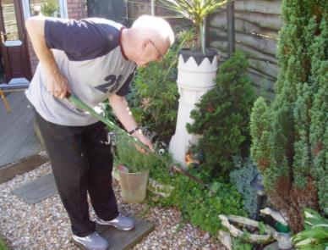
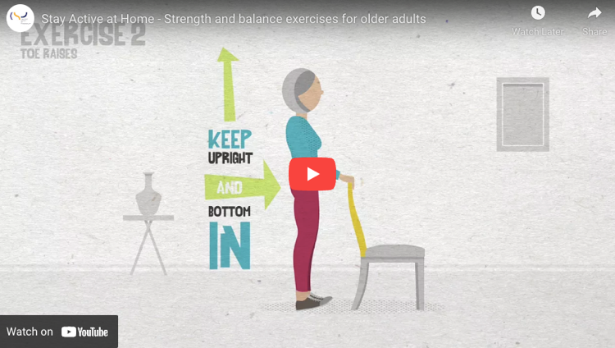
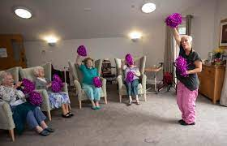
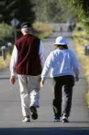
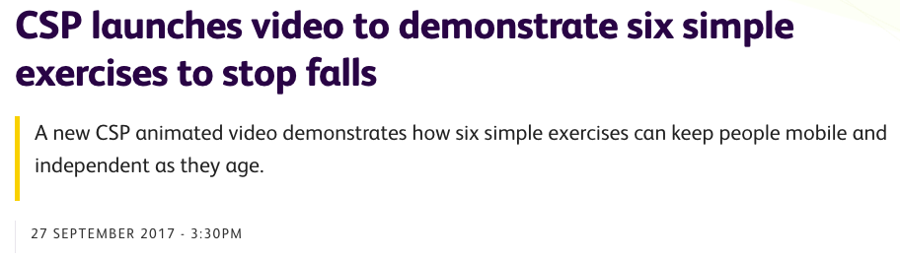
No evidence for ….

Slide 27
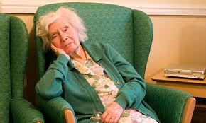
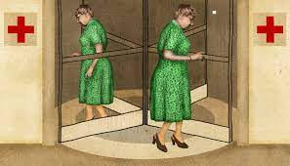
Inactivity, Frailty & the revolving door
If they receive 6-8 sessions with you and are then discharged, they will stop exercising and any gains made will be lost
Over a 4 year period¹:
Those who were less active became more frail
Those who were frail sat more
Uni-directional relationship between frailty and activity
Those who sit for >8hrs/day (self report) are 3 times more likely to be diagnosed with frailty than those who sit for <4 hrs/day²
¹Mañas et al. J Cachexia Sarcopenia Muscle. 2020; ²Li et al. BMC Public Health 2022

Slide 28
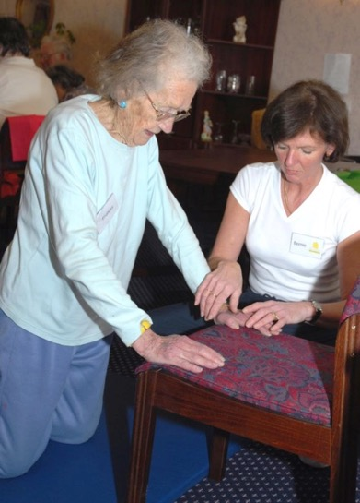
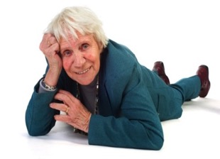
When is falls exercise a ‘treatment’ rather than a ‘supplement’?
You wouldn’t give a cancer patient only half the dose of chemotherapy…..
Or give them a different drug that was not known to work

Slide 29
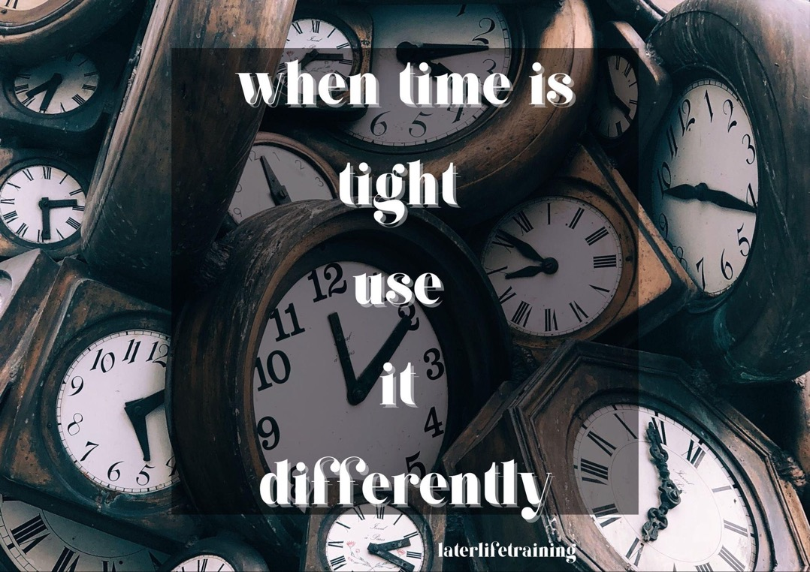
Therapy services cannot support effective dose
If you only have 6-8 contacts with someone, make it count
  Otago exercise programme unsupervised home exercise with support visits and phone calls over a year
Seek out evidence-based options to transition your patient onto when they leave your care
Have a detailed talk about the need for ongoing exercise for best outcomes, dispel myths and support behaviour change – EDUCATION

Slide 30
Indications for different evidence-based falls or generic strength and balance training programmes

Slide 31
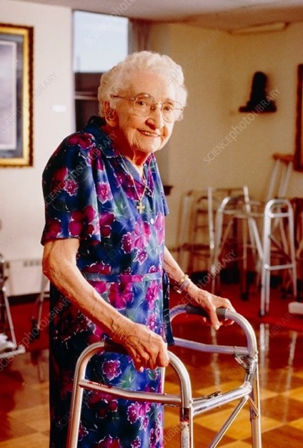

Different programmes for different people
Individual Differences
Specificity
Progressive Overload
Reversibility

Slide 32
Does all physical activity improve strength & balance?
Not all physical activity impacts on the right components of fitness
Only Tai Chi in this list has any proven efficacy in preventing falls
For those at higher risk, specific individualised programs required
UK Chief Medical Officers' Physical Activity Guidelines 2019
Skelton & Mavroeidi, JFSF 2019
@GCUReach #EUGMS22

Slide 33
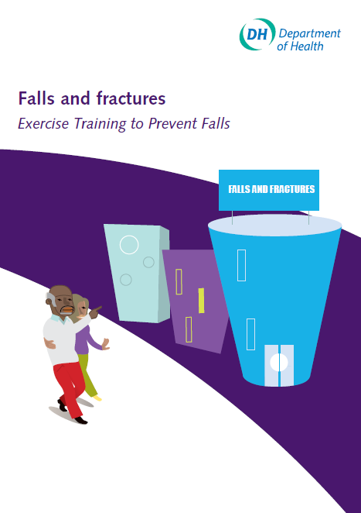
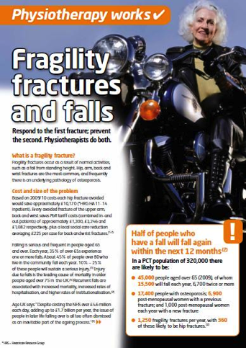
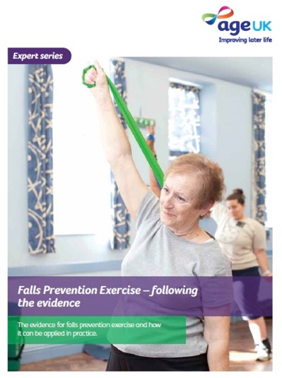
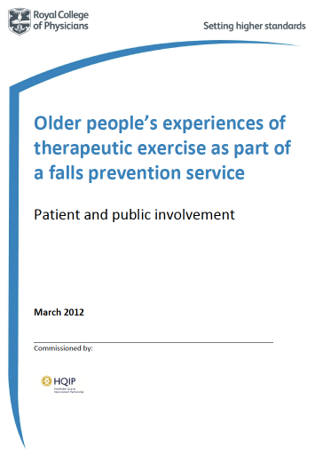
There’s history to recommended fall prevention exercise programmes in the UK
2009
2011
2012
2012

Slide 34
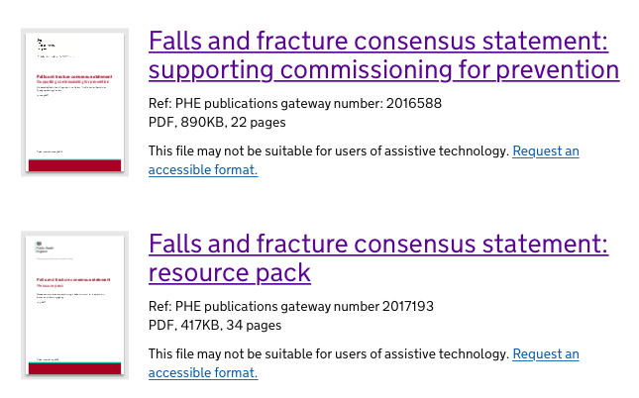
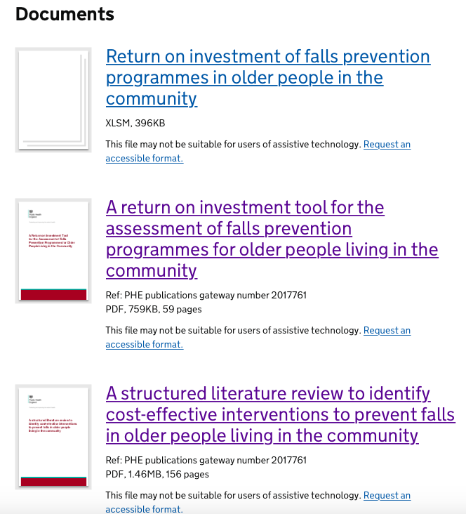
There’s history to recommended fall prevention exercise programmes in the UK
2018
2017

Slide 35
There’s history to recommended fall prevention exercise programmes in the UK
2018
2019
2019

Slide 36
Falls prevention in the UK
Otago Home Exercise Programme (OEP)
  Home based, 1 yr; 3 x p/w; standing strength and balance (pre-set x5 mobility, x5 strength, x12 balance); graded walking programme; 6 home visits and monthly phone calls to progress and support adherence
  Group based, 6 mths, 3 x p/w (one group, two home)
Falls Management Exercise Programme (FaME/PSI)
  Frequent fallers - 9 mths; 3 x p/w (one group, two home); standing strength and balance plus floorwork; specialist exercise instructor to progress and tailor exercise
  Sedentary older adults – 6 months – increased PA/effect lasted a year after intervention
Falls
Injuries
Physical function and QoL
Cost effective >80s
Cost neutral >65s
Cognitive Function
Falls
Physical Function and QoL
Cost effective >65s
Maintain BMD
Change of residence
Habitual physical activity
Long lies
(Campbell 1997; Robertson 2001; Campbell 2005; Liu-Ambrose 2008; Davis 2010; Skelton 2005, 2008; Iliffe 2015; Orton 2021)

Slide 37
Benefits of FaME and Otago: Wider than falls prevention
FaME | OEP
Habitual Physical Activity (using PASE and CHAMPS)^{1,2} | Habitual Physical Activity (PASE)7 (control group got less active, OEP same)
Walking Speed (using 6MWT)¹ | Perceived functional performance⁸
Balance (TUG, BBS, 1LS)^{1,4, 13} | Balance (TUG, 1LS, 4 test balance, Tinetti)^{7,8,10, 11,12}
Strength (30sCR, Dynamometer)^{4, 13} | Strength (30sCR, Dynamometry)^{7,8,10,11}
Power (Nott Power Rig)¹³
Bone Mineral Density (DEXA) Maintenance^{5✥13}
Quality of Life (SF12)¹ | Quality of Life (SF36)¹¹
Fear of falling (FES-I)¹ | Fear of falling (FES-I)7, (control group became more fearful),11
Socialisation and participation (qualitative)^{1,3}
Expectations of Exercise (OEE)^{2,6}
Confidence (ConfBal etc)^{2,3,4,6} | Confidence (ConfBal)¹²
Risk of death (mortality 3 year3 post)³ | Risk of death (mortality 12 months post)⁹
Moving into care³
Avoiding long lies (ability to get up off floor)^{3, 13}
FaME Refs: 1. Yeung PHCR&D 2015; 2. Iliffe HTA 2014, BJGP 2015; 3. Skelton, Age Ageing 2005; 4. Gateshead ROI 2017; 5: Skelton JAPA 2008 ✥ 9 month programme (not seen in 6 month programme, Duckham Age Ageing 2015); 6. Gawler AGG 2016. 13. Skelton et al. JFSF 2019.
OEP Refs: 7. Campbell BMJ 1997; 8. Shubert FrontiersPH 2017; 9. Thomas Age Ageing 2010; 10. Benavent-Caballer Physio 2016; 11. Kyrdalen Physio Res Int 2014; 12. Hawley Hague Physio TP 2017

Slide 38
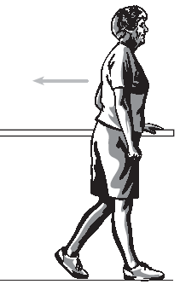
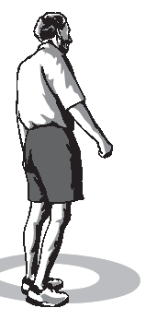

Otago – prevents falls
A 1 year prescriptive, structured home exercise programme
Designed to be tailored (individualised), based on thorough assessment of balance and physical function
Designed to be completed at home unsupervised 3 x per week
  With regular home visits and telephone calls for both progression of balance challenge and ankle weights and for motivational support
More effective on balance outcomes if delivered in a group once a week (+ home exercise) compared to home based only format
Participants could (by the end) do challenging balance activities alone at home
Reduces falls rate by 18-45% depending on population and duration
Campbell, BMJ 1997; Robertson, BMJ 200; Kyraldsen et al. Phys Res Int 2014; Albornos-Munoz et al. J Adv Nursing 2018; Deverall et al. Inj Prev 2019; Aranda-Reneo et al. Healthcare 2021
#LLTOEP

Slide 39
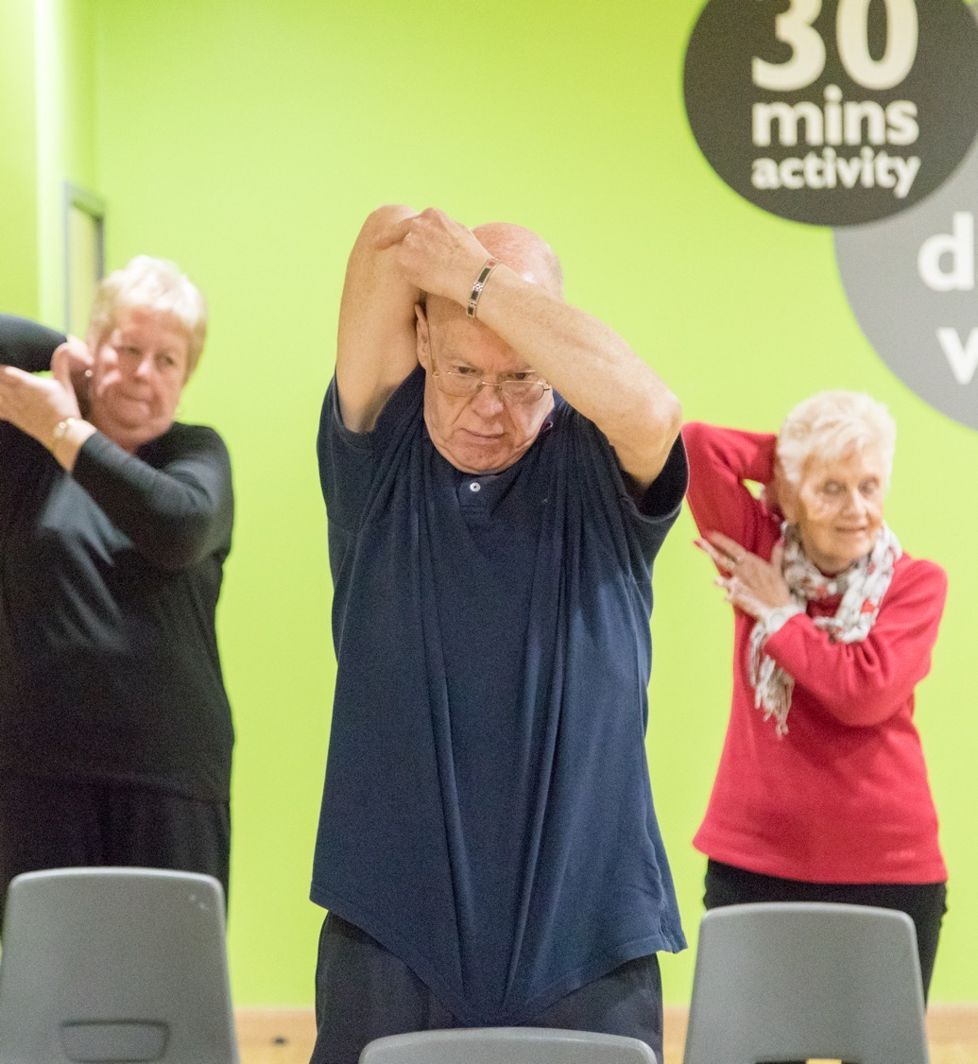
FaME – prevents falls
24-week structured exercise programme delivered by Postural Stability Instructors
Group based with individualised tailoring for ability and progression
Challenges balance, improves strength, regains stepping reactions and skills to get up from the floor
Increases in difficulty and resistance over time
reduces falls rate by between 26^{1,2}-54²% (depending on population and duration)
Increases habitual physical activity (> 105¹-167² minutes per week by end of programme)
1. Iliffe et al. BJGP 2015 (sedentary older people at risk, 6 months)
2. Orton et al. Age Ageing 2021 (people at risk of falls, 6 months)
3. Skelton et al. Age Ageing 2005 (frequent fallers, 9 months)

Slide 40
Original Research Otago/FaME participants – who were they?
 | Otago (Campbell 1997) | Otago (Robertson 2001a) | Otago (Robertson 2001b) | FaME (Skelton 2005) | FaME (Iliffe 2015) | FaME (Orton 2019)
Age (yrs, mean, sd) | 84.1 (3.1) | 80.8 (3.8) | 83.6 (2.8) | 72.7 (5.8) | 72.9 (6.1) | 76.8 (8.3)
Men | 0% | 32% | 31% | 0% | 38% | 27%
Fallen in previous year | 41% | 36% | 45% | 100% (3 or more times) | 22% | 20% (in prev. 3 months)
Walking Aids or care at home | 22% community care | 16% meals on wheels 26% cleaning | 13% meals on wheels 41% cleaning | 18% walking aids | 13% walking aids | _
Medications (no, mean, sd) | 3.7 (2.7) | 2.9 (2.3) | 3.8 (2.1) | 4 (3.8) | 3 (2.6) | 52% over 4 medications
Campbell, BMJ 1997; Robertson, BMJ 2001 x 2; Skelton, Age Ageing 2005; Iliffe, BJGP 2015; Orton Age Ageing 2021

Slide 41
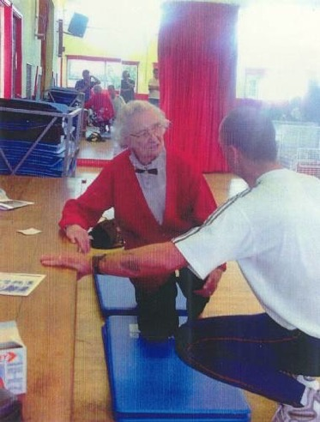
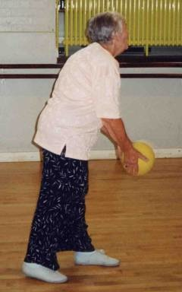
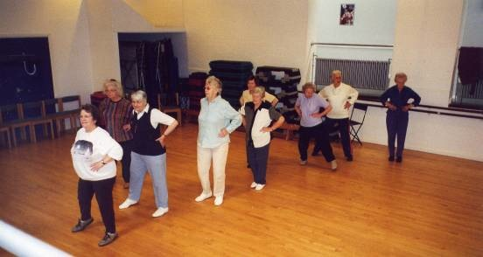
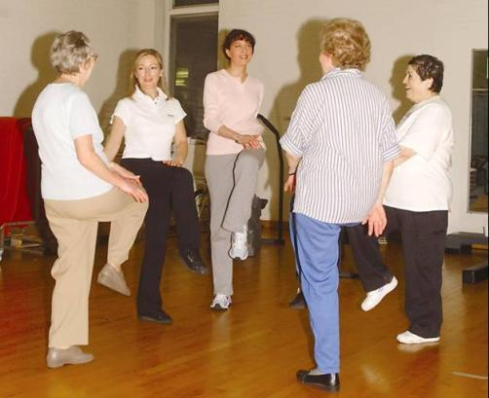
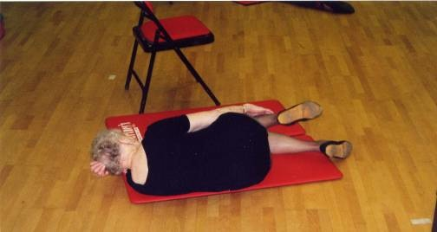
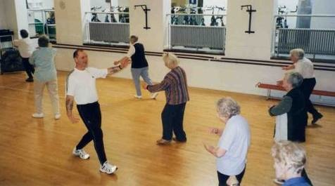
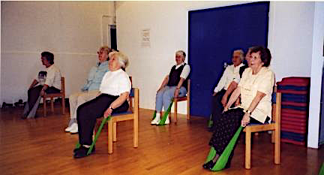

Slide 42
Violet’s story….FaME benefits
FaME was developed when there were no falls services in the UK, so no referral from therapy. Recruited women who had had 3 or more falls in last year.
Started FaME
  Needed transport to get to class, used a walker, very sedentary, multiple medical conditions (managed), previous hip fracture
FaME 3 months in
  Using a stick, started attending local U3A and AgeUK lunch clubs, still attending FaME, first time to the floor since her hip fracture
FaME 6 months in
  Got the bus to the class, uses stick outdoors only
FaME 9 months in
  No longer needs walking aid, uses the bath again, started playing tennis again with 3 old friends
Value of prolonged engagement in progressive structured exercise

Slide 43
OEP and FaME are not the same
 | Otago | FaME
Deliverers – original research | Physiotherapists, District Nurses, Exercise Instructors | Exercise Instructors
Deliverers – real life | Above + Technical Assistants | Exercise Instructors
Delivery style | Home-based with support Group-based + home | Group based + home
Evidenced (best) for | >80s with a history of falls | Frequent fallers Lower risk sedentary older people
FaME Instructors (PSIs) can deliver Otago Exercise Programme (within scope & training)
Otago Exercise Leaders cannot deliver FaME

Slide 44
Emphasis on different component of fitness
Otago (OEP Leader) – Strength & Balance | FaME (PSI) - Multicomponent
Warm up – 5 mobility exercises | Warm up – Circulation boost and mobility
 | Endurance – aerobic Interval training incl. balance challenge and gait/step variability
Balance – 12 exercises – static and dynamic | Balance – Static & dynamic, propulsive, reactive
Strength – 5 exercises all lower body, 3 with ankle weights | Strength – work through all major muscle groups, using bands, free weights and body weight
Walking programme | Backward chaining method & floor coping strategies
 | Stretches – lower and upper body
 | Adapted Tai Chi

Slide 45
Otago and FaME are not the same
Otago Exercise Programme
Pre-set programme 24 exercises (lower limb only)
5 mobility, 5 strength, 12 balance, 2 flexibility
Plus walking
Plus specific support schedule for home exercise
Is a standing programme (Otago can’t be seated!)
Suitability determined by physiotherapist
Specific population group to most benefit (not for all older people!)
OEP Leaders (Exercise Instructors)
Should hold minimum L2 Fitness Qualification
Need support/shouldn’t be working in isolation/follow guidance*
Should refer back if out of scope*
Training focus on group management skills
New format for NHS settings about to be launched - one to one and behaviour change focus

Slide 46
Otago and FaME are not the same
FaME
7 evidence-based activities/multicomponent
Includes getting up from floor skills
Designed as a group programme
Includes need for home exercise to achieve dose
Evidenced to increased PA minutes as well as reduce risk and rate of falls
FaME could be appropriate for wide range of older people - and all exercises progressed ++
No ceiling affect like Otago Exercise Programme
Otago exercises form part of the exercise base (particularly the home based prescription)
Postural Stability Instructor's (PSIs)
Should hold minimum L3 Fitness Qualification
Best to work in partnership but can work in isolation*
Should refer back if out of scope*
Training focus on group management skills, tailoring, assessment, progressions and working with wide range of capability from primary to secondary prevention
Seated skilling-up may be required
Many PSIs hold also hold other specialist exercise qualifications and may also be Otago Leaders

Slide 47
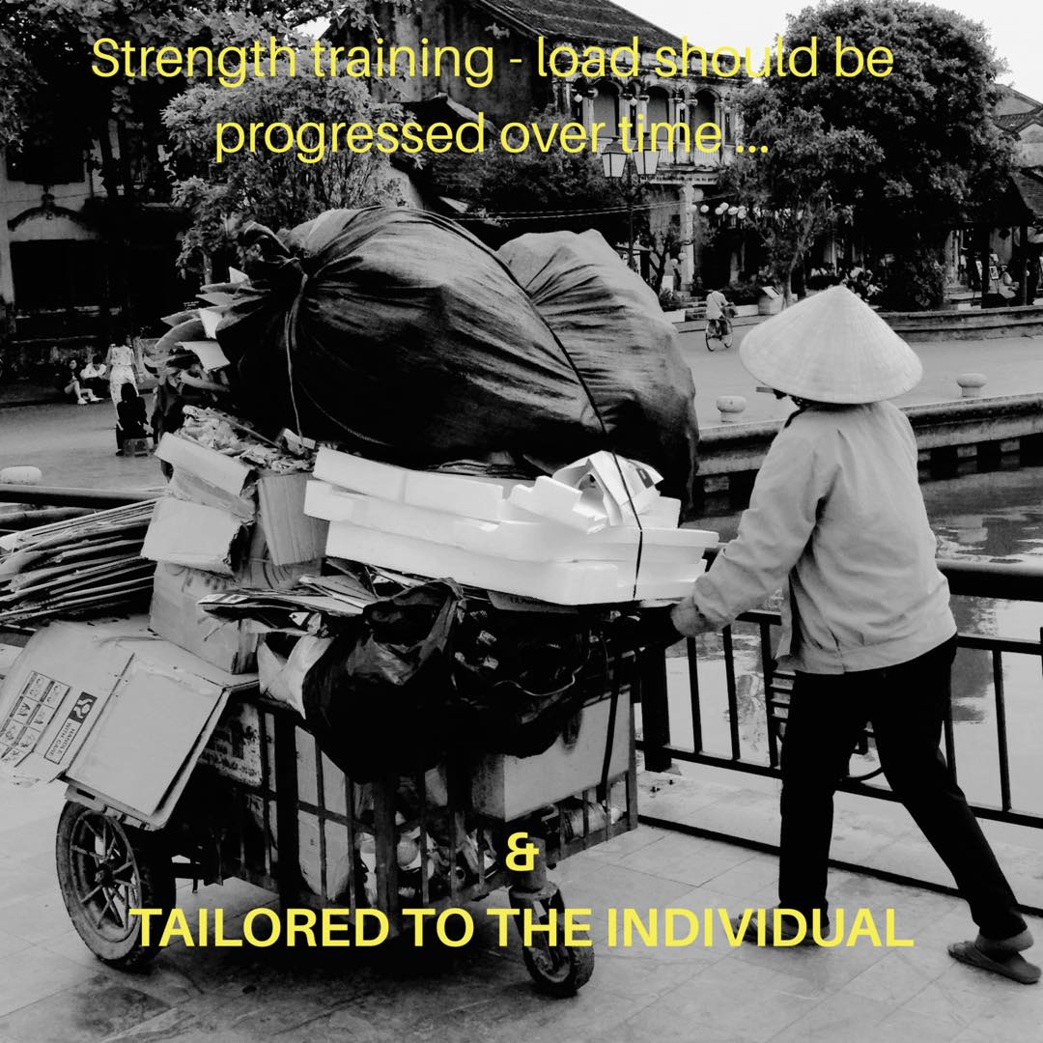
Why a generic older person’s exercise session won’t cut it

Slide 48
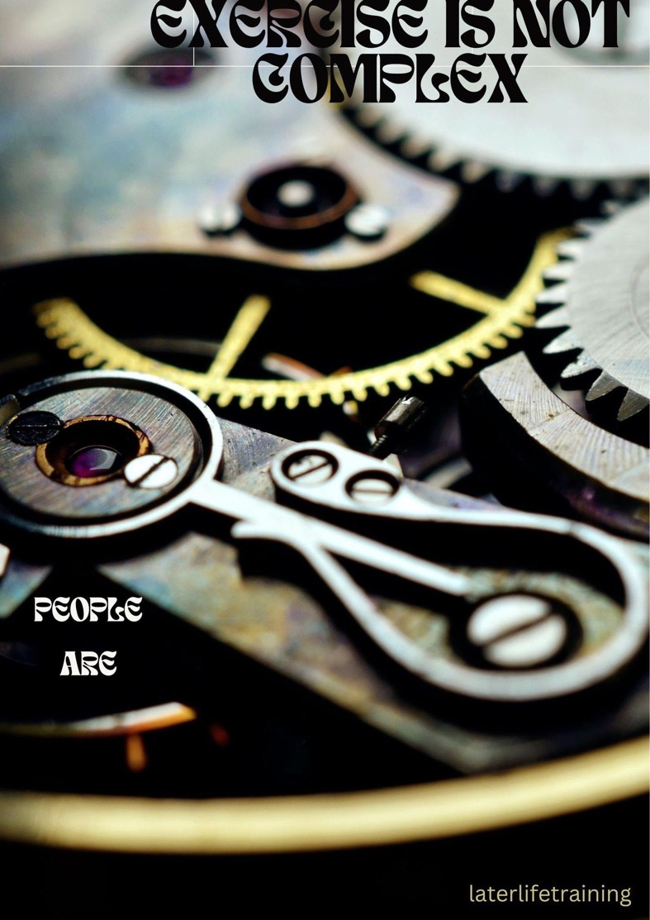

Any exercise instructor knows how to work with strength training and fitness… but most don’t know how to adapt for older people or those with multiple conditions and most don’t know the evidence based programmes that work to prevent falls

Slide 49
Supervision needed to support safe continuation in exercise
Potential of increased adverse events - falls
Both Otago and FaME studies originally excluded people who were frail enough to require one to one physiotherapy (as could not exercise safely at home)
Home exercise program (based on Otago) on discharge from hospital (physiotherapist home visits, 10 times over 12 months)¹ Improvements in mobility but also increase in falls (40%)
Supervised exercise is more effective than unsupervised exercise in Parkinson’s Disease² In people with advanced disease minimally supervised exercise may increase risk of falls
Best to refer them onto someone who can supervise their continuation/progression
¹Sherrington et al. PLOSOne. 2014; ²Allen et al. Cochrane Review 2021
World Falls Guidelines, Age & Ageing 2022

Slide 50
Suitably trained professionals to support EB falls prevention
People
The actives
In transition (pre-frail)
Older people living with frailty
Strength & Balance (S&B)
Generic S & B programmes
All components of fitness/Tai Chi/ condition specific
Evidence based Otago or FaME
Settings
Exercise in leisure or community settings
Exercise in leisure or community settings
Home care, care settings, acute settings
Workforce
Personal Trainers, Strength coaches etc.
Tai Chi instructors, L3 Exercise referral instructors
PSIs can assess, prescribe, progress and tailor exercise (L4 instructors)
OEP Leaders can support a prescription from a physiotherapist or PSI
Otago Leaders, Postural Stability Instructors (FaME), Clinical Exercise Physiologists & Physiotherapists
#LLTOEP

Slide 51
FaME – service evaluations
‘Staying Steady’ classes, based on the FaME programme, for 20 weeks.
Improved strength, balance and confidence, reduced fear
Supported by public health funds of £19,146 (approx. £120 per head)
Estimated savings of at least £968,736 compared to the spend on public health without this investment
http://www.gatesheadopa.org.uk/news/sroi/
Steady Steps Programme, Edinburgh (FaME/PSI)
24 weeks
Hedley et al. Physio Theory Practice 2010
http://www.ukactive.com/stream.asp?stream=true&eid=9333&node=733&checksum=7828DF5A0C894287854E4AA7F147C9DE

Slide 52
What is the current state of play on referrals between physiotherapists and exercise instructors to support longer-term exercise participation?

Slide 53
Physiotherapists – what is your current practice to support longer term exercise post-discharge?
Log on to: www.menti.com
Use code: 37 35 006
  A) I refer people to evidence based falls prevention exercise programmes in the community ? (agreed pathway with agreed referral form)
  B) I recommend people to evidence based falls prevention exercise programmes in the community ? (verbal recommendation or a list – no referral information transferred)
  C) I provide a list of a number of exercise and physical activity opportunities nearby?
  D) I provide a selection of exercises they can keep doing at home
  E) None of the above

Slide 54
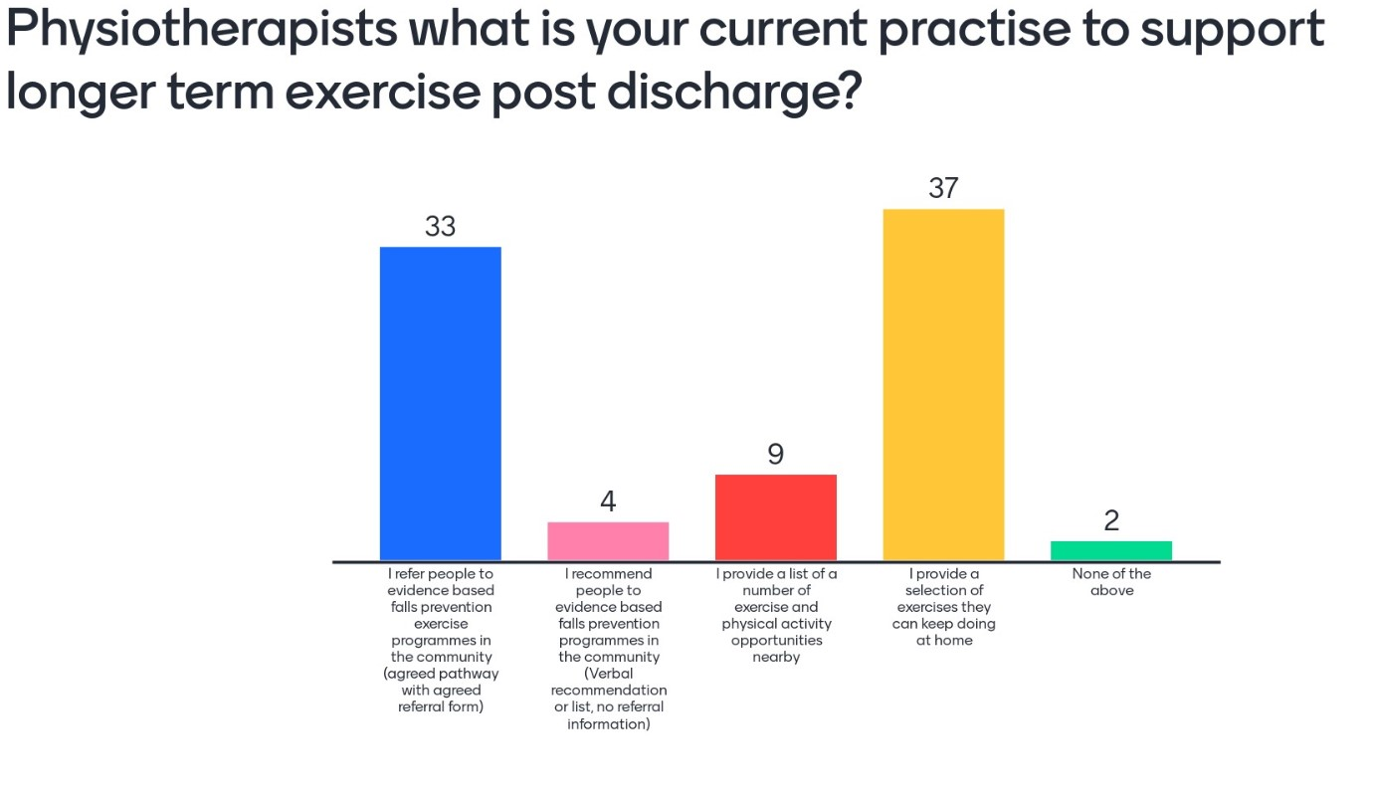

Slide 55
Exercise Professionals (OEP Leaders/PSIs) – do you get referrals into your sessions?
Log on to: www.menti.com
Use code: 2584 9584
  A) I can get referrals from therapy services? (agreed pathway with agreed referral form)
  B) I can get a recommendation from therapy services? (verbal recommendation or a list – no referral information transferred)
  C) I can get referrals from local GPs (but not from therapy)
  D) I don’t get any referrals, people self-identify/refer themselves

Slide 56
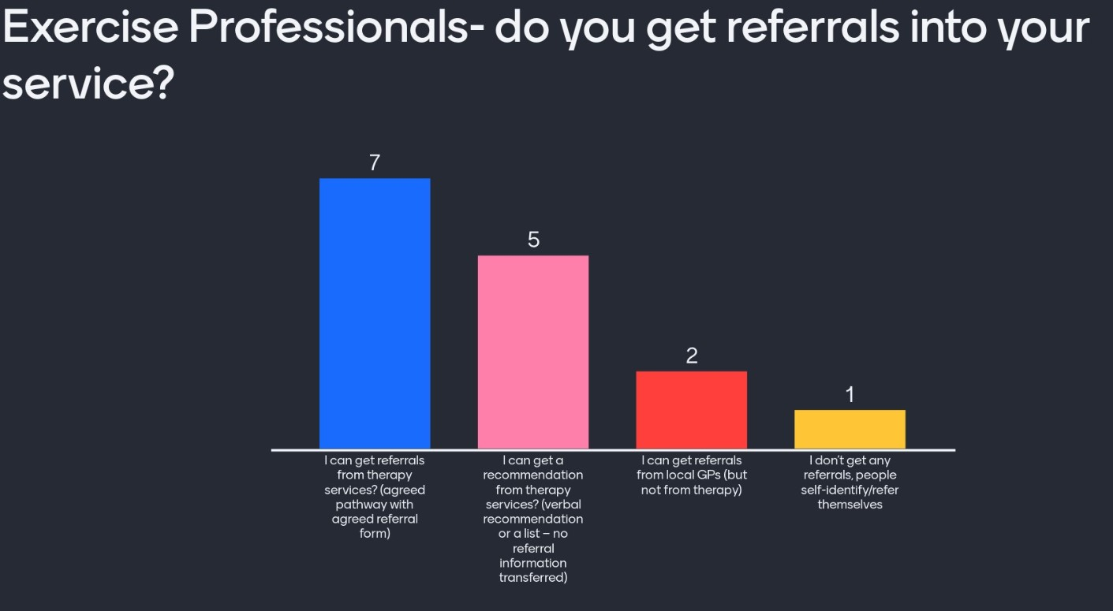

Slide 57
Exercise Professionals (OEP Leaders/PSIs) – what are your current referral options?
Log on to: www.menti.com
Use code: 5435 1920
  I have the ability to refer (formally or informally) people back into therapy services if I think they need a MFA or they are not ‘improving’ with exercise
  I recommend a client gets their GP to refer them (or they self refer) back into the local falls service or to physiotherapy if I identify it is needed

Slide 58
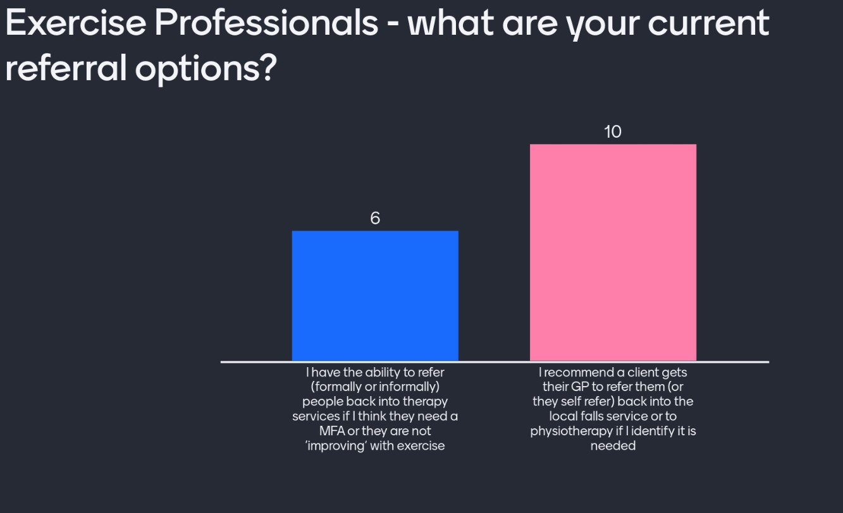

Slide 59
What’s the state of play?
Currently few people referred or formally recommended to EB falls prevention exercise delivered by trained instructors in the community
  Patients in falls services not being supported to meet dose
  Revolving door?
Currently few people attending EB falls prevention exercise in the community come from therapy settings
  Mostly reaching the low-mid risk older adult, may be reducing the need for them to attend falls services
  No easy access to MFRA in a falls service if needed
We are working in silos and not providing a seamless exercise service to support at risk older adults

Slide 60
Rationale for high quality information sharing which follows the individual throughout their falls exercise pathway

Slide 61
Partnership working for best possible outcomes
Referral Forms are designed to support decisions for:
  suitability into OEP, FaME
  environments/venues, required supervision/class numbers
  baseline exercise selection
  challenge recommendations
  progression
  tailoring
  scope of practice and insurance
https://agile.csp.org.uk/content/referrals
https://laterlifetraining.co.uk/agile-endorsed-falls-exercise-referral-form/

Slide 62



Appropriately trained professionals
https://agile.csp.org.uk/content/referrals
Montero-Odasso et al. Age Ageing 2022
A standardised ‘Referral Form’ for transfer of assessment and treatment information from the physiotherapist to the exercise professionals trained in Otago or FaME
- To continue to build on their exercise journey for better gains
Notes:
Seated exercise programs run by volunteers trained for a few hours in a few exercises will NOT be able to adapt, tailor or progress exercise 0 importance of suitably trained ex professionals in the pathway – and revolving door – if they don’t get enough dose with therapy they will end up back there very soon!

Slide 63


Why the referral form helps
Best starts
Targeted exercise prescription
Optimal outcomes
Returning at your doors less likely
Nurturing ‘best starts’ is part of supporting behaviour change over time
Notes:
We need to get people off to the best start - progress their recovery and transfer that information on
This ensures effective dose from the outset and hits the mark sooner
So we can we optimise outcomes - not settle for half a job
Better outcomes (from better adherence bcs tailoring was hitting the mark means you are less likely to see them back at your door
In the short time you have as physiotherapists - you are the people who can nurture the longer journey to full potential

Slide 64


Why the referral form helps
They build a bridge (not create ‘end points’) - self referred individuals who need referral back to MDT or therapy
It’s not ‘OK’ to suggest they can go anywhere if you want the best outcomes for your patient
Montero-Odasso et al. Age Ageing 2022
Notes:
A referral form, as opposed to a list of opportunities in the local area, shows commitment to the journey, importance of the right sort of exercise, understanding of the skill set that specialist exercise instructors have and al this gives confidence to the older person…

Slide 65






Right exercise programme, Right person
- Motivated for home exercise?
- Motivated for group?
- Medical conditions / are they frail?
- Fearful or have had long lies?
If self-referred, or do not show improvements over time - would they benefit from a MF assessment and therapy input?

Slide 66

The long and the short of it
The Referral Form
  continues gains - with a specific prescription directed by the referrer
  shares information about what has already happened - needed to develop a prescription that meets the health, functional, social and motivational needs of the patient (FaME/PSI)
  ensures a seamless transition across settings and providers for the patient’s exercise journey
The Short Referral Form
  Agreement that the individual doesn’t require physiotherapy intervention - individual would benefit from targeted exercise support to prevent further functional decline or fast-track to proven falls prevention exercise programme
  Particularly important if, for example, chair-based opportunities are not appropriate if they need further balance input

Slide 67


Feedback so far
“We don’t refer, we’re not allowed to..”
“It looks good, what we need but why is there a short form? (we won’t be using it)..”
“It’s too long, even the short form..”
“It’s just what we need…”
“We don’t need a referral form, people refer themselves ..”

Slide 68



What does this initial feedback tell us?
Referral not fully understood (that it supports baseline exercise decisions, not just suitability)
Varied experiences and thoughts about what’s needed
Confusing/inaccurate information about what is ‘allowed’
There is a a clear difference of opinion around the requirement for referral information amongst physiotherapist and exercise professionals – why is this do you think?

Slide 69
Barriers to Implementation of FaME/Otago in practice
Within the NHS in the UK, falls exercise…..
Average duration 8 weeks and frequency once per week
  Ineffective dose
More than half the session seated
  ? Highly challenging balance
Little or no strength progression
  Lack of resistance band or ankle weight progression
No floorwork (FaME)
  Key element to reduce fear and increase confidence
54% of sites had staff who had completed Postural Stability Instructor (PSI) training and 41% of sites had staff who have completed Otago (OEP) training
Physiotherapists rarely referred people onto exercise opportunities after ‘discharge’
RCP Exercise Falls Audit 2012

Slide 70

What barriers are there to you using the new referral forms?
Log on to: www.menti.com
Use code: 1669 7788
Give us up to 3 words (3 barriers)

Slide 71


Slide 72
Overcoming barriers to optimising outcomes for those who have fallen/are at risk of falling

Slide 73



How many trained OEP Leaders or PSIs are out there?
LLT. Not for Profit Training Company set up 2003. Training developed with funding from the Department of Health
Trained over 4000 FaME instructors (PSIs) - exercise instructors, physiotherapists, occupational therapists and nurses
Trained over 3500 Otago Exercise Leaders - exercise instructors, physiotherapists, occupational therapists and nurses
Specialist exercise qualification within UK National Exercise Referral Framework [L4 Skills Active Endorsed Falls Qualification]. Now CIMSPA endorsed.
AGILE – specialist interest group of Chartered Society of Physiotherapists – Tutor on course and encourage transitions.

Slide 74





Slide 75


Best practice - Therapy to Community Exercise Provision
Rotherham (2017) Pathway specifically to aid transition on for effective dose requirements
12 week NHS therapy exercise… then
12 week group Otago exercise community based program
Followed by unlimited time strength and balance sessions (FaME)
63% of people transitioned on to FaME sessions
Reduced hospitalisations and injuries
Therapy led rehabilitation
NHS – 12 weeks
Referral from GP
Not eligible for rehabilitation but could benefit from S & B programme
Otago program
Community OEP Leader
12 weeks
FaME program (Active Always)
Community PSI led
Ongoing
Other S & B programs / Tai Chi
#LLTOEP
Hawley Hague, Physio Theory Practice 2017

Slide 76
Cambridge Falls Pathway
Falls Assessment: Identification of a falls problem and screening to determine risk factors *
Motivation Pathway
Therapy led (based on Otago/FaME)
Secondary Prevention
Self-referral
Chair Based Exercise Class
(Community based)
OTAGO
Group programme
(Community based)
FaME group programmes (Community based)
Exercise Referral Scheme
Primary Prevention
Community based classes for older people
Notes:
Added in assessment box: * undertaken by an appropriate person
AGREE but changed font so can see easier ;)

Slide 77


Enabling older people to get up, stay up and live their best lives
National FaME Implementation Team:
Later Life Training
AGILE (older adults SIG Chartered Society of Physiotherapy)
AgeUK
ROSPA
FaME Services (CIC, Council)
FLEXI Research Team

Slide 78



https://laterlifetraining.co.uk/n-fit-national-fame-implementation-team/

Slide 79
Finding the PSIs/Otago Leaders
FB - https://www.facebook.com/groups/laterlifetrainingprofessionals
E-mail - info@laterlifetraining.co.uk
Google OEP Leader/PSI Instructor (your town)
Contact Local Council Activity Lead
Contact Local Public Health Falls Services

Slide 80

What words do you now associate with the referral forms?
Log on to: www.menti.com
Use code: 4130 0351
Give us up to 3 words

Slide 81


Slide 82

Resources to support achieving dose and seamless falls prevention exercise care pathways

Slide 83

SB during Covid-19 and impact on falls
Restrictions to activity due to Covid-19
older adults reduced their physical activity
(126 mins to 77 mins per week strength and balance activity 2019-2020)
Modelling on first lockdown (3 months) period in England predicted
>250,000 more falls in 110,000 people
costing £211 million over next 2.5 years
Underestimate!
(PHE, 2021. https://bit.ly/36nGGbL)
@GCUReach @LaterLifeTrain

Slide 84

Covid-19 wider impacts: Key Recommendations
For targeted populations:
For the whole population
Promote and increase availability of strength and balance activity for older adults, involving a gradual increase in activity in order to reduce falls risk and to enable safe and confident participation on other forms of exercise and physical activity
Ensure physical activity recovery measures reach those who stand to benefit most from them, including older adults who shielded, with multimorbidity, with dementia, in social care settings and from more deprived backgrounds
Identify locally which older adults have reduced their levels of physical activity during the COVID-19 pandemic, with a focus on populations where the largest reductions are likely to be found. The largest reductions in strength and balance activity identified in this report were seen in males aged 65 to 74 and females aged 65 to 84
Refer older adults with functional loss, transition towards frailty or fear of falls resulting from deconditioning to appropriate rehabilitations services
Raise awareness amongst health and social care staff of post-COVID-19 syndrome, communicating the risks of building up levels of activity levels too rapidly and the need to refer to post-COVID-19 syndrome clinics where symptoms are severe

Slide 85




NFPCG ‘Deconditioning’ Resources
Developed 5 evidence based resources to promote reconditioning of older people post COVID pandemic
Public/ patient facing; healthcare professionals; commissioners/ providers
Easy read (including adapted version for visual and hearing impairments); poster for waiting areas
Launched April 2022
Hosted BGS Website: https://www.bgs.org.uk/resources/deconditioning-information-for-providers-of-services-for-older-people-and-the-public
Notes:
Developed 5 resources intended to support individuals, health and care professionals and commissioners to take action to help older adults become more active and recondition following activity restrictions in the COVID-19 pandemic.

Slide 86

Driving quality provision
OHID (Public Health England) National Falls Prevention Coordination Group
  Supporting fidelity and dose for effective falls prevention
  Consensus Statement for Commissioners
  Return on Investment local data input for Otago, FaME and Tai Chi
  Quality Markers for service improvement audits
© Dawn SKELTON
@GCUReach #EUGMS22

Slide 87

Raising-the-bar-on-strength-and-balance-full-report.pdf (ageing-better.org.uk)
Notes:
Centre for Ageing Better commissioned the University of Manchester to bridge the gap between evidence and practice S&B training provision as there is a great deal of variation in what is provided across England
This report presents the models of delivery, issues, barriers and innovative solutions with a focus on community-based strength and balance programmes targeting all older adults – offering 5 themes which should be taken on board to ensure that strength and balance exercise programmes are delivered to the right people, at the right time, and by the right workforce/people and achieve positive results.

Slide 88


Hope: @Place/ICP Impact

Slide 89


CALL TO ACTION
Physiotherapists
  Find your local Otago Leaders or Postural Stability Instructors (try google/Public Health or email LLT)
  Build links and start referring on to support effective dose and stop revolving door
Otago Leaders / Postural Stability Instructors
  Share the Referral Forms and Guidance Documents with local falls and therapy services
  Make yourself known and give them a list of available classes and (if applicable) costs
  Tell LLT if you have tried to approach local therapy services and have been told you cannot be a referral option for them
Commissioners of services
  Ensure a seamless local exercise pathway across sectors/organisations to support return on investment and better patient outcomes
Info@laterlifetraining.co.uk
Agile.fallsofficer@gmail.com

