Slide 1
Hip Sprint Local
Improving patient outcomes post hip-fracture

Slide 2
What is it?
Quality improvement in action
Local data collection
Fostering collaboration between CSP members
Driving up standards for our patients
Improving access to Physiotherapy
A community of learning
A network of peer support and ideas
An opportunity to share success

Slide 3
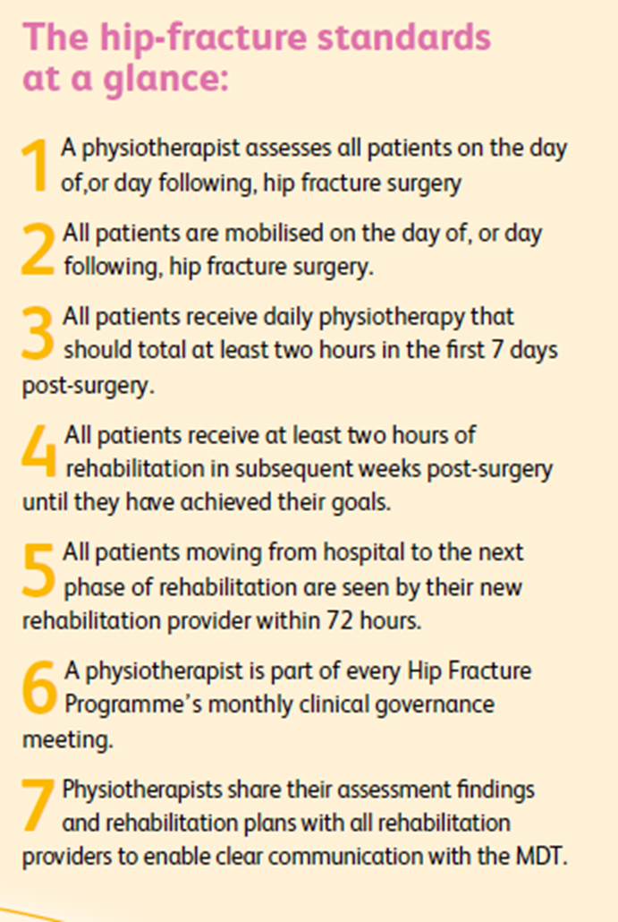
What’s it all about?
The Hip Fracture Standards:

Slide 4
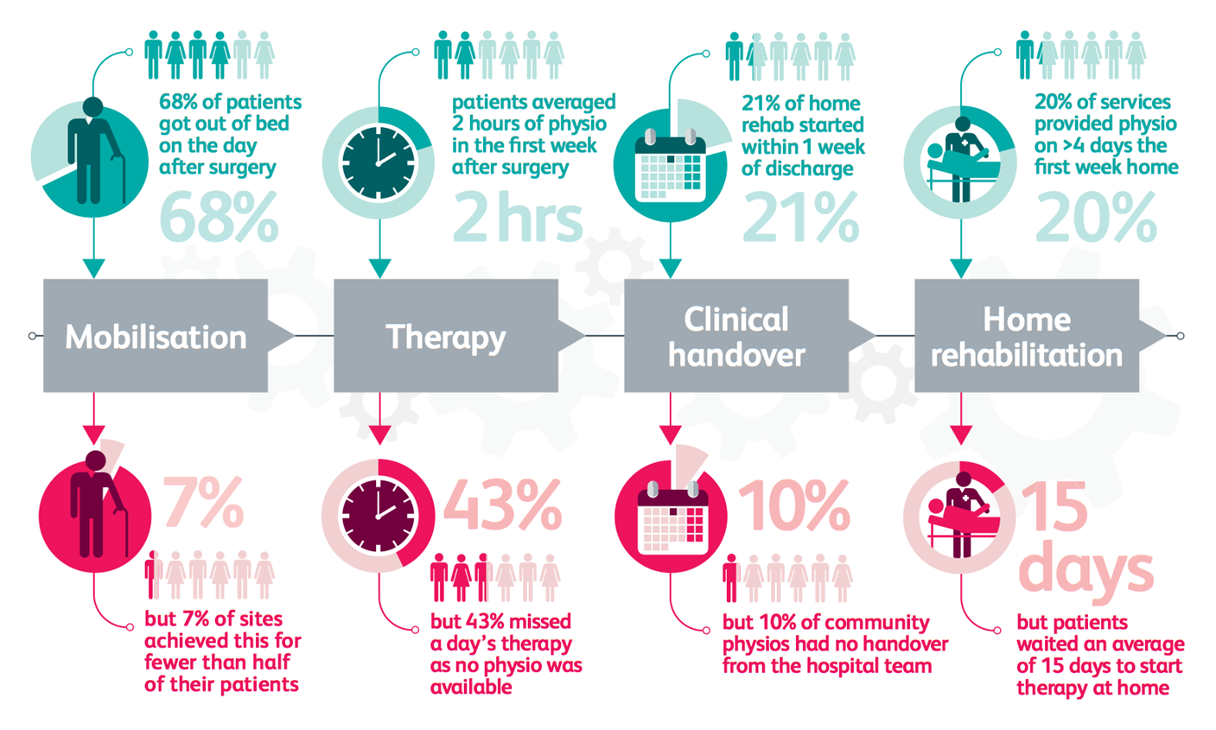
What’s there to improve?

Slide 5
How do I get involved?
Visit the CSP Hip fracture rehabilitation web page – here
Join your regional Hip Sprint Local Hub - here
Familiarise yourself with the 2018 Hip Sprint RCP audit – here
Watch out for and attend Hip Sprint Local events in your area
Let your AGILE representative know if you are currently doing (or have done) work to implement the CSP Hip Fracture Standards locally
Let your AGILE representative know if you are happy to share your work and network with colleagues at the Hip Spring Local events
Collaborate with AGILE to raise the profile of your work further

Slide 6
And follow
@thecsp
@AGILECSP
#HipSprint

